Slide 1
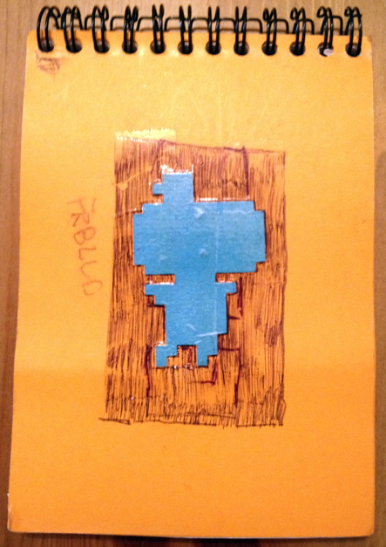
Cubes All The Way Down
FEZ Technical Post-Mortem By Renaud Bédard, Programmer (Polytron)

Slide 2
About Me
Started messing with 3D programming in VB6 & Truevision3D around 2001
Started working with Phil Fish on FEZ in April 2007
FEZ gets 2 nominations and 1 award (Visual Arts) at IGF'08
Bacc. in Computer Science at UQÀM in late 2008
Worked full-time since then at Polytron to make the game
FEZ is first commercial title and full-time “industry” “job”
Notes:
Here’s a little backstory before we begin

Slide 3
2D/3D Exploration Puzzle Platformer (“mystroidvania”)
Pixel art where the pixels are 3D trixels
Platforming in 2D, but across all 4 orthographic views
Built in XNA/C# from the start
Spanned 5 XNA versions, from 1.0 to 3.1!
Notes:
If you’re here, you probably heard of FEZ before, but here goes The game plays like a 2D platformer and looks like one, but the world is actually 3D and traversible on every side of its cubic shape.

Slide 4
Long Screenshot

Slide 5
How is the world “cut up”?
Art and level production-wise, easier to work with tiles
Plain old 2D tilemap doesn't work : we need 3D tiles
...triles?
16x16x16 trixels chosen as an arbitrary fixed trile size
Notes:
So you’ve probably noticed that the world is built out of repeated cubic chunks. That’s a design decision and here’s how it came about.
The pixel art aesthetic made it natural to consider a tile-based world
Megatextures and unique geometry was a little bit too ambitious for 1 artist and 1 coder, and non-reusable assets is scary
Axis-aligned tiles also makes for easier culling, possibly even hierarchical

Slide 6
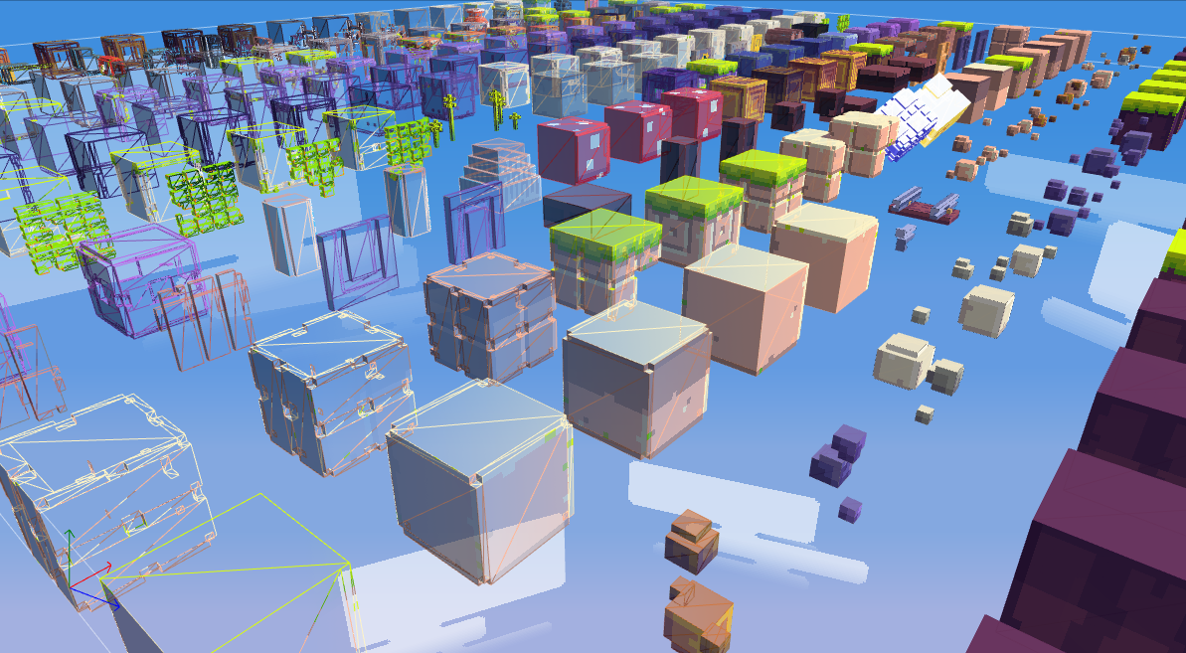
Nature Trile Set (302 triles)
Notes:
So these “trile sets” are composed of all the possible “triles” that can appear in a single level. We have many of them, here’s the main “nature” one, and overlaid with the wireframe.
I’ll go over how these are modeled and textured.

Slide 7
Texturing Triles
Per-trixel coloring?
Implies good painting tools in modeler
Cubemaps! (freebloods)
Triles need to be convex
Cubemaps are 16x16x6 32bpp = 6Kb uncompressed!
Notes:
FEZ has no palette limitation by design Phil is used to Photoshop and emulating the color manipulation tools (gradients, color spaces, palettes, layers) is hard/time-consuming
Cubemaps can (and will) copy pixels to inside faces for concave shapes, but it's usually impossible to see in isometric views
One discrete texture per trile means a crapton of texture switching, so atlasing is a must

Slide 8
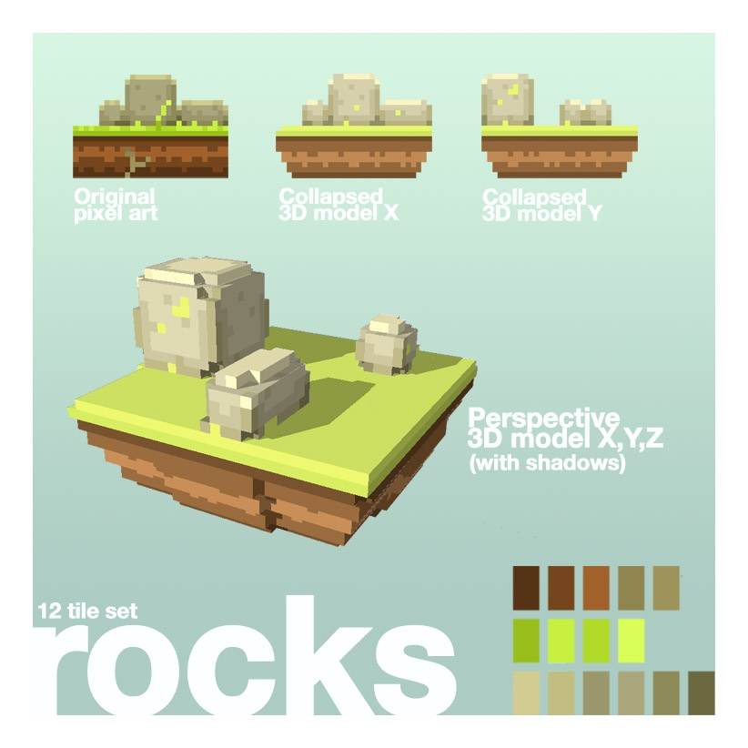
Modeling Triles
First trile concepts made in Google Sketchup
Notes:
Sketchup was good to test out visual styles, but it's clearly not made to carve this kind of geometry, took forever to do it.
Also you can't export with the free version.
I had no idea how to make a Maya/MAX/C4D plug-in, and these are expensive to license.

Slide 9
Modeling Triles
Trixel sculpting
Push trixel faces in, pull faces out
Adaptative geometric complexity
Notes:
In the end I decided to implement trixel sculpting inside the world editor itself, since that made the most sense as a workflow.
The mesh gets simplified in realtime as you sculpt it!
You start with a full 8-face cube and just grab chunks out. Again, texture is already managed externally.

Slide 10
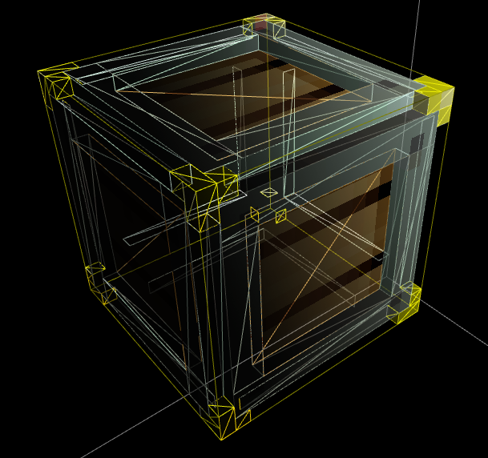
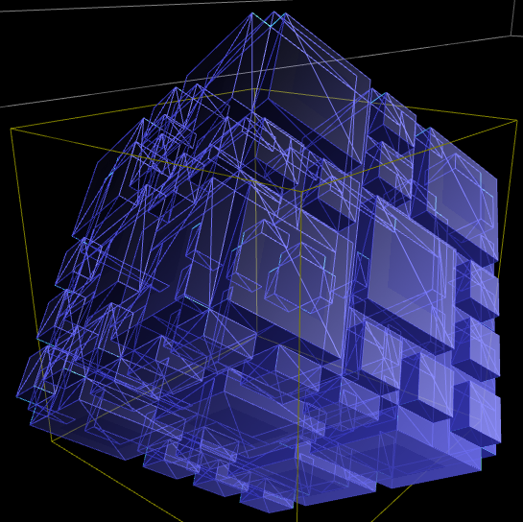
Modeling Triles
And things can get pretty complex
Notes:
Even though all surfaces are planar, there can be pretty complex triles, and it shows when the world rotates. It adds that extra polish that makes FEZ FEZ.

Slide 11
Mesh Simplification
Extrapolate contiguous surfaces from trixels
For each surface,
Enumerate biggest rectangles in that surface
Each rectangle becomes a plane
Triles have an average of 136 polygons
Typical scene : 50,000 polygons on-screen
Goes from anywhere from 5000 to 250,000
Notes:
A trile is composed of trixels, I keep track of their presence like voxels.
From that, it's possible to detect all the outwards-facing faces for trixels that have no neighbour, and list surfaces.
Then from these surfaces, I use 2D spiral traversal from the center of the surface to tag the biggest possible rectangle in each surface.

Slide 12
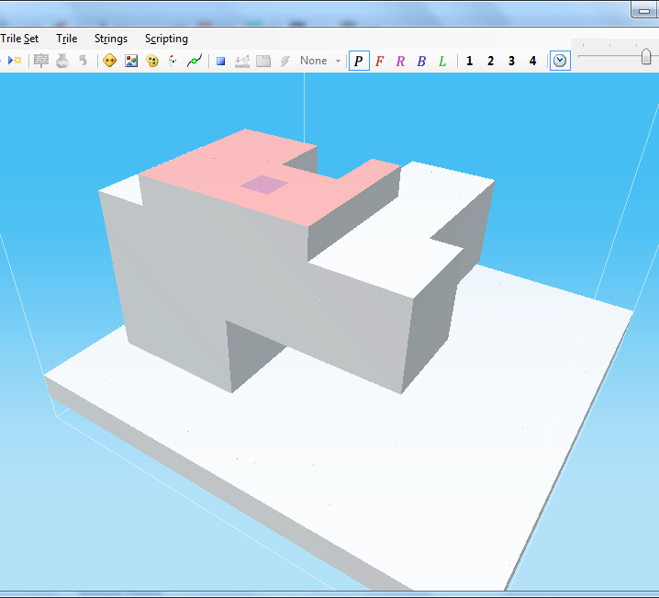
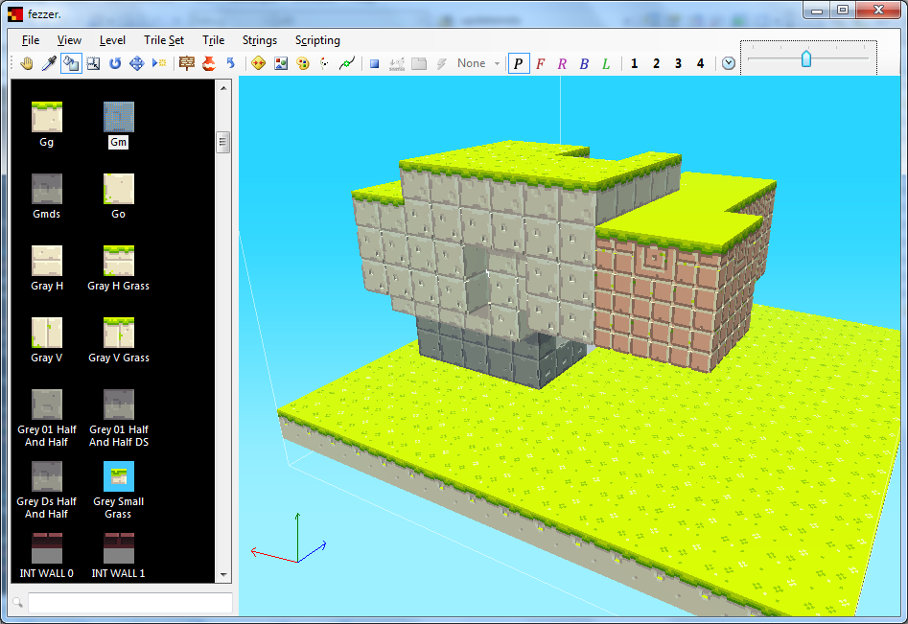
Building Levels in “Fezzer”
Notes:
Building levels is much like sculpting triles, but for the whole level! By default all the blocks are white and untextured, so you can build the level like Legos, and then load a tile set and “paint” it. There is also a tool to group stuff together, move it around, rotate triles, etc. Everything’s done from the editor.

Slide 13
Rendering Triles : Culling
Orthographic views
Peel the frontmost layer
Keep offset and see-through triles
During rotation transitions
Peel the two visible faces
Always use frustum culling
Only cull the difference, leave what’s still visible there
Notes:
Since all triles are individual, I can cull them out independently, so long as there’s a fast algorithm to know what has not to be rendered. By walking through the triles from the position of the camera for each 2D cell, there’s ways to reduce the amount of visible triles by a LOT and do some kind of occlusion culling without getting into GPU queries.

Slide 14
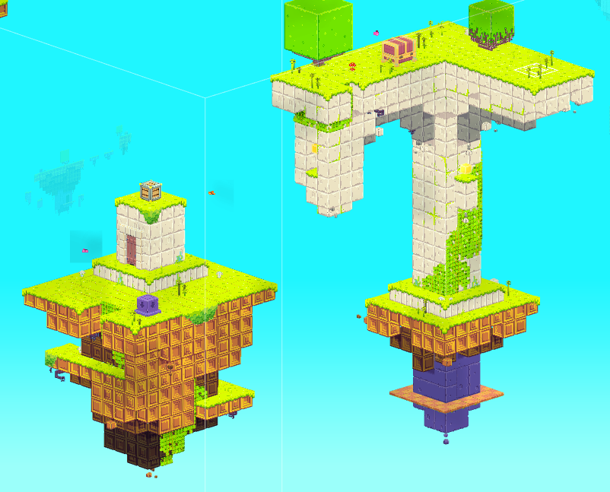
Culling Disabled

Slide 15
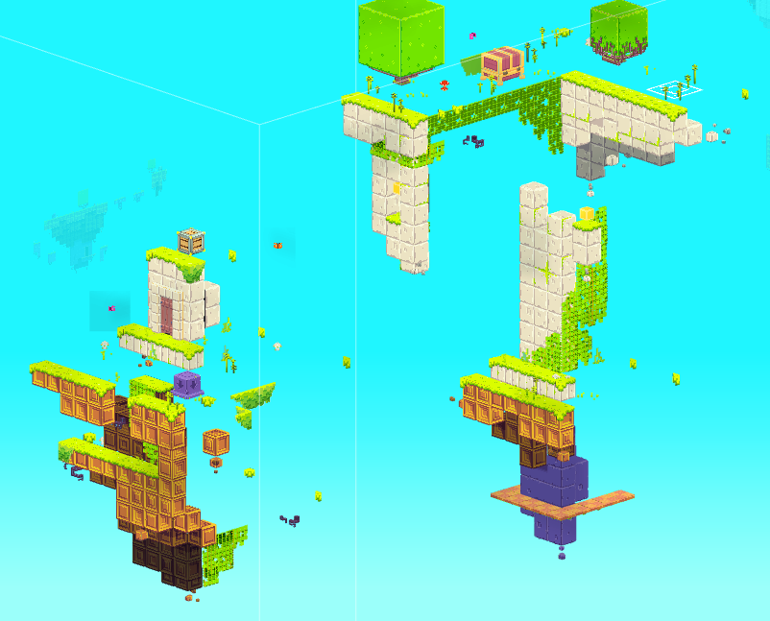
Culling Enabled
Notes:
Absolutely no difference visually from non-culled version (in the right viewpoint)

Slide 16
Rendering Triles : Instancing
Lots of instances of the same trile in a level
Few things specific to a single instance
XYZ Position, Y Rotation : 4 floats
vfetch Instancing on Xbox 360 ≈ SM 3.0 Hardware Instancing on PC
Max. 226 instances of same trile per draw call
Notes:
226 => Theoretical maximum of 256, but some other VS constants taken by uniform parameters or constants

Slide 17
Instancing shader details
Instance data passed as VS constants
#define InstancesPerBatch 226
float4 InstancePositionPhiArray[InstancesPerBatch] : register(c30);
Reconstruct transformation matrix in VS
float sinPhi, cosPhi;
sincos(InstancePositionPhi.w, sinPhi, cosPhi);
float4x4 instanceMatrix =
{
cosPhi, 0, -sinPhi, 0,
0, 1, 0, 0,
sinPhi, 0, cosPhi, 0,
InstancePositionPhi.xyz, 1
};

Slide 18
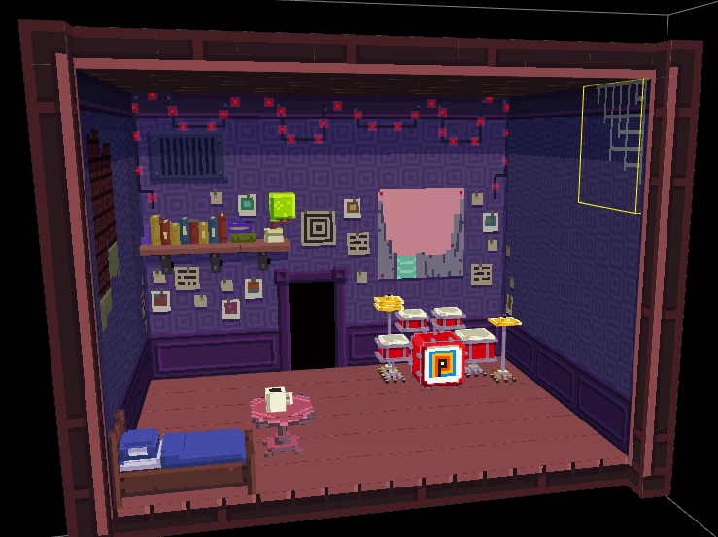
Other World Objects : Planes/Decals
Where sculpting doesn't matter, or sprite animations
Notes:
Gomez’s house and many other house interiors are mostly composed of planes because you can’t tell the difference, and it’s easier to draw a whole slab of 2D art than split it in 16x16 chunks. Other planes include explosions, NPCs, Gomez and wildlife. Animated trixels is a no-no.

Slide 19
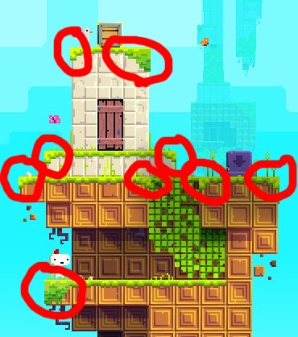
Other World Objects : Art Objects
For small overlapping details, or unique bigger landmarks
Notes:
Art objects are sculpted and textured very much like triles, and are also instanced.

Slide 20
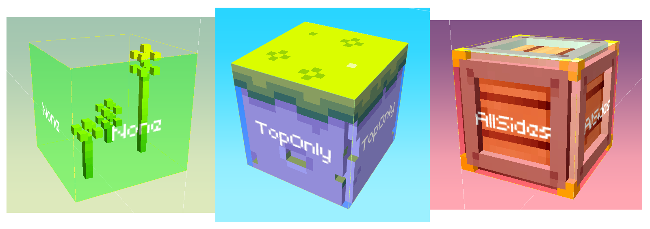
Collision Management
Triles are the collision map
Four types
Immaterial (e.g. blades of grass)
No collision (background elements)
Top-collide (most platforms)
All-collide (blocking boundaries)
Notes:
Since the world is primarily made of all these little blocks, it makes sense to just give them collision information and let the game use that directly.
So there's four possible collision types in there.
All-collide isn't used all that much, but comes up in interior closed-up areas.

Slide 21
Invisible Collision Triles
Art objects are filled with invisible collision triles
Notes:
Since the triles are the collision, for art objects that are decoupled from the trile system, we actually need to fill them with triles that have no geometry just to hold collision information. These are costless to the renderer.

Slide 22
Collision Lookup
Level is a large structure of triles indexable by (x, y, z)
Actually a Dictionary<Int3, Trile>
You collide with what you see
Get closest (x, y) or (z, y) row of triles
Traverse to nearest collideable trile and use its properties
Gets tricky with offset triles
Look up 4 closest neighbour rows and test
After that, normal AABB to line collision resolution
Notes:
So how does collision work in-game, seeing as I'm not traversing the world in 3D?
I treat the world as a list of trile rows. Every 2D tile on the screen is actually a stack of tiles and I only typically see the end of it.
If there are non-collideable tiles in there, I can skip them and search for the real collideable data, and use that.
I only need to make a handful of these lookups, for Gomez and moving platforms.
Now when I implemented trile offsets (meaning the triles can be moved at the trixel level instead of whole triles), I had to complexify the algorithm.
The game needs to search across all 4 closest rows to try and collide with offset triles that may or may not be inside these.
There's many optimizations that were done to this structure/algorithm but I'll come back to them later.

Slide 23
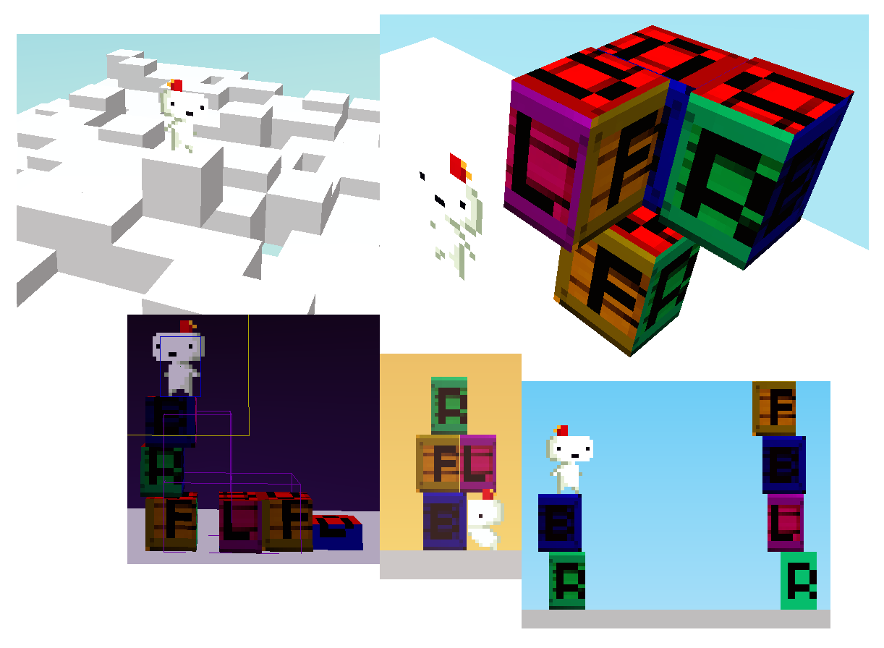
Offset/Non-Unit Triles
Notes:
These are the “offset triles” I’m talking about. A trile is not necessarily in the center of its grid space, which makes for collision and culling problems. Then the grid of triles acts like a partitioning structure, and the trile is kept in the closest grid space that contains it. When looking up collision, I only need to check the 4 nearest neighbours at most, so it’s simpler than it seems.

Slide 24
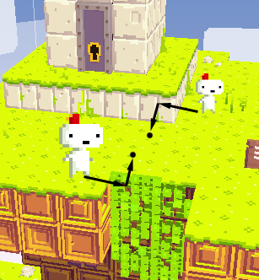
How Gomez Moves Around
Movement is in 2D according to the current viewpoint.
When the camera rotates, movement (and time) is suspended.
Depth correction
Gomez should stay visible at all times
Gomez should never walk in mid-air
Otherwise, don't change Gomez's depth arbitrarily
Notes:
So FEZ is a 2D/3D game. Gomez navigates the world in his 2D perspective. How do we adjust his depth position and still make sense spatially?
1. Gomez shouldn't disappear behind the background, unless it was specifically tagged as immaterial
2. Gomez shouldn't float or fall after a rotation, so his depth component needs to be clamped to some ground if he finds himself floating
3. Otherwise, don't mess the player's perception. If there's no input or "dangerous case", leave the depth alone.

Slide 25
Background Mode
If Gomez is behind geometry after a rotation, don't panic!
Silhouette rendering
Low-pass music
Limited actions
Notes:
In the initial builds of FEZ (2008 and earlier), Gomez used to panic, emit a loud sound effect, show a red exclamation mark and require a quick-time-event to get out of there.
This happens way more often than you'd think, and really kills the mood.
So we decided to implement background mode, which just hints at the player that he's not in a good position to act, and let him come back to the foreground.

Slide 26
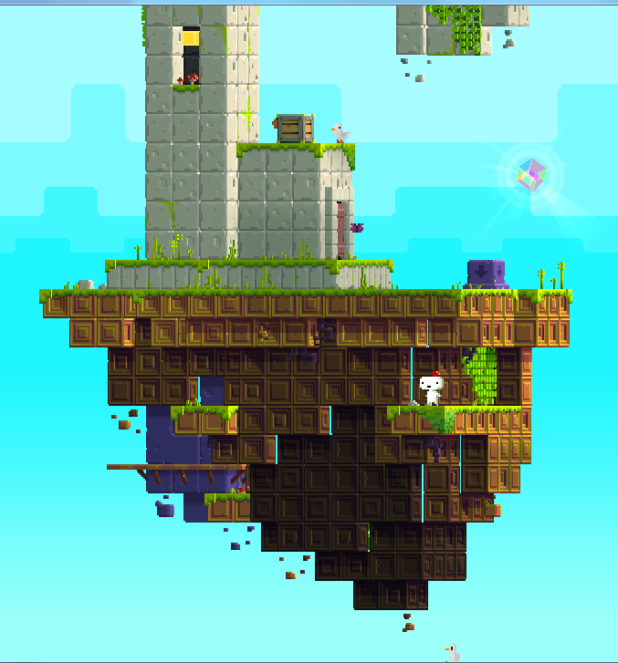
Lighting
Per-face direct/diffuse light
Ambient light based on sky background color
Also tints transparent cloud layers
Shadows and additional lights added in screen-space
All done in a lighting pre-pass (render-to-texture)
Blended in Modulate2X mode so that it can light up and shadow

Slide 27
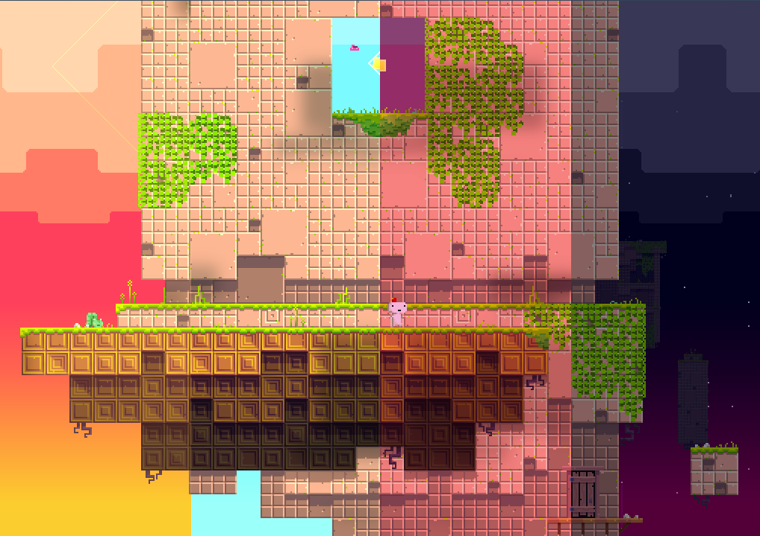
Time of Day Lighting
Notes:
Here you can see the effect of the time of day on ambient light, cloud tinting and effects like the stars fading in and the cloud shadows becoming less apparent.
There is also a post-processing overlay during dusk, dawn and nighttime to add even more crazy tinting.

Slide 28
Dynamic World Interactions
FEZ @ IGF’08 was 99% static
Now Gomez can :
Grab/push/pull objects
Rotate parts of the world independently
Make blocks crumble under his weight
Grab ledges all around platforms
Interact with one-off puzzle objects
Swim in water & drown in toxic liquids
AND MUCH MUCH MORE!
56 different action classes control his behaviour

Slide 29
Action “Objects For States”
All player action classes derive from a base abstract class
Not all mutually exclusive
“Fall” is an action that is evaluated as long as there’s gravity
Tied to sprite animations, player controllability, etc.
protected virtual void TestConditions()
{
}
protected virtual void Begin()
{
}
protected virtual void End()
{
}
protected virtual bool Act(TimeSpan elapsed)
{
return false;
}

Slide 30
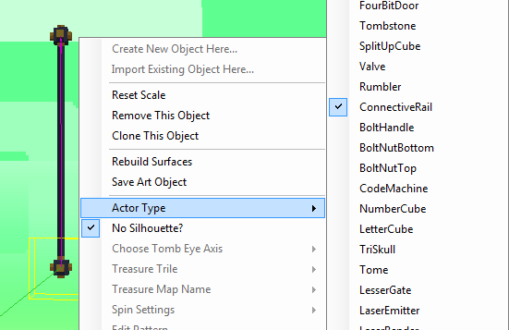
Dynamic World Entities = Actors
Spinning blocks, interactive structures, etc.
Hardcoded behaviours with flags or parameters set in the editor
Tradeoff for not having proper scripting support

Slide 31
Scripting System
Designer-friendly UI (no code!)
Event-based (no continuous evaluation)
Extensible and backwards-compatible
Notes:
I wrote a basic scripting system for FEZ from scratch, which may have been overkill and certainly took me some time to get to work properly. I wanted to make sure that Phil doesn’t mess with code (like lua or c#script), because I know he couldn’t have done it. Also since it was started in late 2009, there was a lot of work to do on the game still, so it needed to be future-proof.

Slide 32
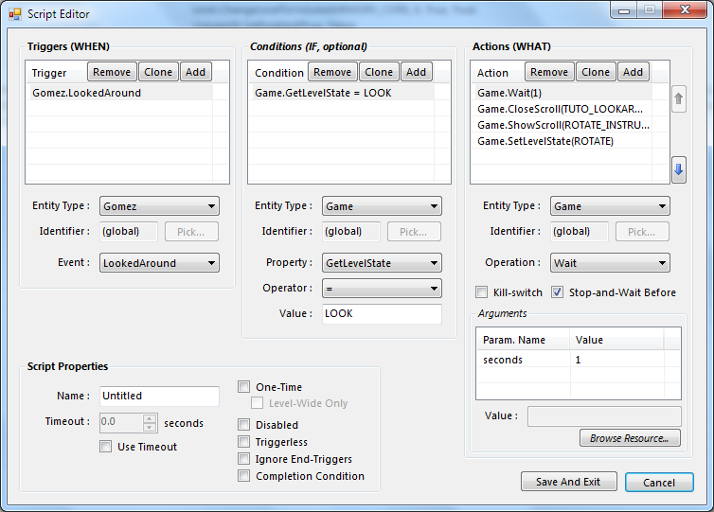
Final Script Editor UI
...is scary.
Notes:
It turns out that supporting everything that a scripting engine should with only a visual UI means a LOT OF CHECKBOXES AND DROPDOWNs.
Most of the “picking” is still done by clicking on objects, which is good, and very little typing is required. But yeah, lots of clicking. Events, Conditions, Operations and Parameters
Also, it’s limitative; most script “actions” end up being hardcoded complex actions that are just called by scripting events.

Slide 33
Serialized Scripts
script key=0 {
name "Untitled"
triggers {
trigger {
event "Start"
object {
type "Level"
}
}
}
actions {
action {
operation "SetPixelsPerTrixel"
arguments "2"
object {
type "Camera"
}
}
}
}
Scripts are objects, serialized as text inside the level file
Tweakable by hand
If you are careful with braces
Probably should’ve written a better formatter like :
script key=0 {
code “Level.Start => Camera.SetPixelsPerTrixel(2)”
}
Notes:
A good thing with the scripting system is how they are very object oriented and they serialize by themselves to text.
Though the result is kinda hard to tweak, even form me, and a better formatter would’ve helped with quick tweaking & debugging.

Slide 34
Scripting Interfaces
Reflected by the editor to fill dropdowns
[Entity(Static = true)]
public interface ILevelService : IScriptingBase
{
// Events
[Description("When the level starts")]
event Action Start;
void OnStart(); // Called by the engine to trigger the event
// Properties
bool FirstVisit { get; }
// Operations
[Description("Smoothly changes to a new water height")]
LongRunningAction SetWaterHeight(float height);
}
Notes:
This is how a scripting interface looks like. The implementation is usually the manager for that entity, and holds all the logic. LongRunningActions is just a way to have an action not be instantaneous, and tell the scripting system when it’s done, or be aborted, etc.

Slide 35
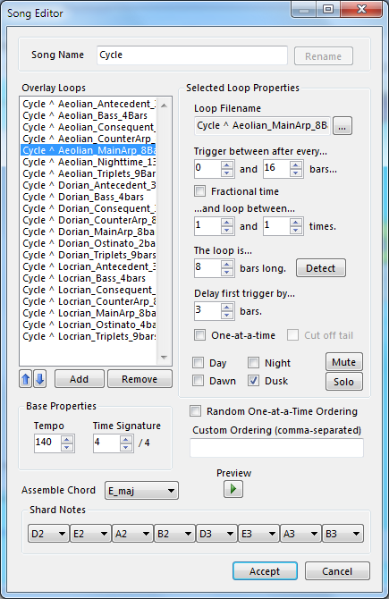
Music System
Written on-top of XACT
Allows dynamic track-based songs
Works with time of day
Horribly intricate and complicated, as requested by Disasterpeace!
...but allows for kickass songmaking
Notes:
I also wrote a music system because we really wanted music to be a significant part of “the FEZ experience”. Songs are dynamic, change randomly over time, composed of many tracks and change dynamically with the time of day. They can also be scripted, so that going higher up in a level changes the song. It’s not “sequenced” however, all tracks are xWMA soundfiles. The “notes” at the bottom is to indicate which are the notes that sound good with the song, so that the right ones are played was you collect cubes.

Slide 36
Xbox 360 Optimizations
XNA on the Xbox 360 = .NET Compact Framework
Garbage collection every 1Mb allocated, unpredictable, blocking
Draw calls are expensive : batching is essential, instantiate ALL THE THINGS
Defer as many draw calculations as possible to vertex shaders instead of CPU
Otherwise, multithread; 5 (slow) cores at your disposal
Lots of content on the Web about this
...especially since XBLIG games have the same issues
Rules of thumb : avoid LINQ, dynamic allocations

Slide 37
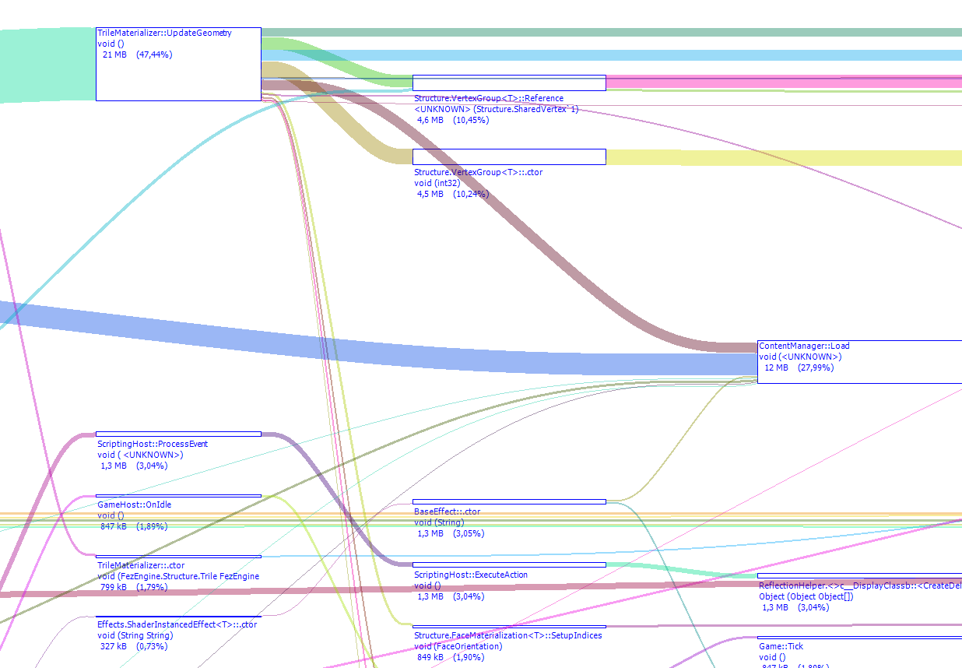
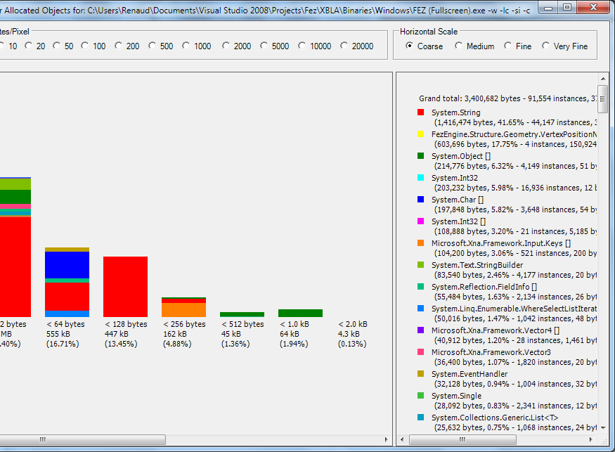
Tools : CLR Profiler
Excellent, free memory profiler
Allocations graphs, memory usage by object
Good for identifying real-time garbage & why load-times stall

Slide 38
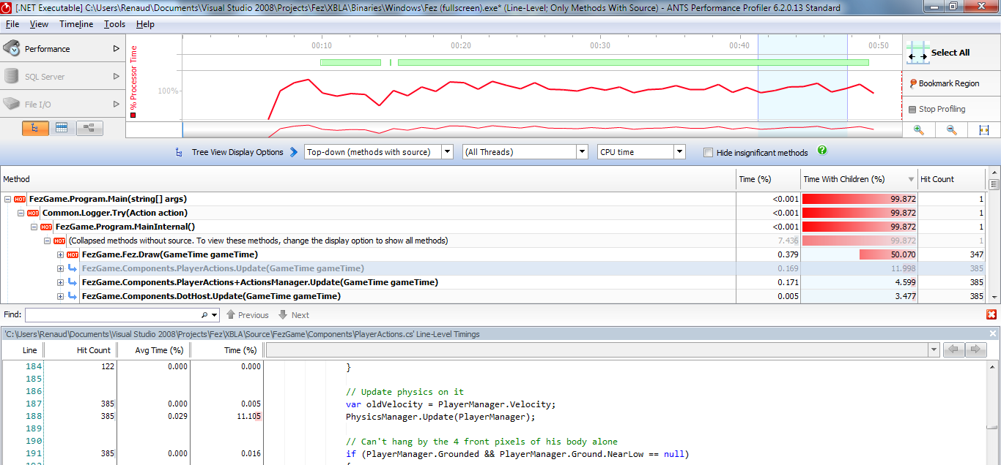
Tools : CPU Profiler
Any one you want (AQTime, dotTrace...)
I like ANTS Performance Profiler a lot
Absolutely essential for finding bottlenecks

Slide 39
Tools : xbWatson, PIX
Come with the Xbox Development Kit
xbWatson
Make your own measurements and output to debug
PIX
Frame-by-frame teardown of what’s costly
Excellent for inspecting the draw calls & shaders
CPU Performance Profiler in the XDK ultimately not that useful
Made for native code, not .NET games
Notes:
I used xbWatson a lot when debugging, but also to find out why the load times were so bad; it’s especially useful to investigate performance issues that are unrelated to the GPU and that happen only on the Xbox (which happens a whole lot)
PIX I only used marginally, to find out shader problems. It’s still really well made and has a lot of useful statistics.

Slide 40
WHAT TOOK YOU SO LONG?
Game started in April 2007
Still in QA in November 2011
What the hell is going on??
Notes:
One of the questions we get the most is “WHEN IS IT COMING OUT”. I’d like to comment on that from my perspective, because the game

Slide 41
Timeline
2007 : Groundwork, engine, editor, “level one”
...for the IGF’08 prototype, eventually scrapped (built in 100 days)
2008 : Celebration, setting up Polytron, art re-draw, engine work while finishing studies, more scrapped levels
2009 : Full-time work begins, world design, art & more engine work
2010 : Design dialogue with Microsoft, internal drama, DOT and world map come in, BMcC & Disasterpeace come in (October)
2011 : Puzzle & cutscene work, more levels, QA, optimization and polishing
Notes:
Turns out making a game is hard. And long. Especially when you’re 2 guys who have next to no experience at making it.
The scope of the game changed constantly. We had the hook, but noa struggle throughout, uncertainty and stress never a good thing in artistic work. (but of course necessary)
The team (originally of 3) crumbled due to personal frictions and creative differences, in early 2010, something that was already somewhat predictable in 2009, so that wasn’t good either. Indies often quote that creative liberty idea of the moment-to-moment until very late in development. Financing the game was and prototyping is what makes good indie games, but you really need a design direction too. Early leak was good for attention but double-edged sword.

Slide 42
That’s all, folks!
Thanks for coming!
Questions?

