Slide 1
Cubes All The Way Down Renaud Bédard Programmer, Polytron

Slide 2
About Me
Started 3D programming in VB6 & Truevision3D ~ 2001
Started working with Phil Fish on FEZ in April 2007
FEZ gets 2 noms and 1 win (Visual Arts) at IGF'08
Bacc. in Computer Science at UQÀM in late 2008
Worked full-time since then at Polytron
FEZ is first commercial title and full-time “industry” “job”
Notes:
Hi! Thanks. Tech post-mortem for FEZ (XBLA, coming out shortly)
Me :
Always been programming, elementary school.
Started 3D high school out of interest, game makin’.
Mostly toyed with visual effects, shaders.
Met Phil on Internet, needed programmer for upcoming project,
Wanted to make 1st game around that time, interested in his visual style/design
3-month prototype gets IGF attention
Finish Bacc. Comp sci
Full-time for 4 years

Slide 3
About FEZ
2D/3D Exploration Puzzle Platformer (“mystroidvania”)
Pixel art where the pixels are 3D trixels
Platforming in 2D, but across all 4 orthographic views
Built in XNA/C# from the start
Spanned 5 XNA versions, from 1.0 to 3.1!
Notes:
If you’re here, probably heard about it...
Lucky that nearly everyone did!

Slide 4
Game Footage
Notes:
To give you an idea of the world aesthetic in action…
Platforming is pretty “realistic” in that it’s not very floaty
Gomez (white guy) is not a ninja
Goal is to collect golden cubes to rebuild an ancient artifact
Interactive levels, navigational puzzles

Slide 5
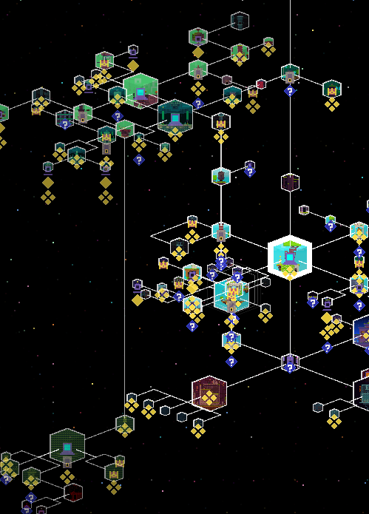
World Structure
Big branching mess, 157 areas total
Each is an isolated level
But level transitions are made “seamless”
Notes:
World is network of interconnected, but self-contained levels
150+ little rooms and larger areas
To give sense of place, level transitions “in the sky” are “seamless” Level loading & setup happens during transition, in another thread
You can see where you went in map, nodes unlock as you go
Map is pretty dense, rendered isometric, and 4-sided nature of game -> need help from game to navigate

Slide 6
How are levels “cut up”?
Art- and level-production wise, tiles are easier
Plain old 2D tilemap doesn’t work : we need 3D tiles
…triles?
16x16x16 voxels (trixels) chosen as an arbitrary fixed size
Notes:
World built out of repeated cubic chunks
- Pixel art aesthetic made it natural to consider a tile-based world (easier to build)
- Megatextures + unique geometry : too ambitious for 1 artist and 1 coder, non-reusable assets = scary
Axis-aligned tiles also = easier culling (possibly even hierarchical)
So how are they organized?

Slide 7
“Nature” Trile Set (302 triles)
Notes:
- “Trile Sets” = all the possible “triles” that can appear in a single level. - 17 of them in the game
- I’ll go over how these are modeled and textured.

Slide 8
Texturing Triles
Per-trixel coloring?
Implies good integrated painting tools
Cubemaps! (freebloods)
Triles need to be convex
Cubemaps are 16x16x6 32bpp = 6kb uncompressed!
Notes:
No palette limitation by design - Phil is used to Photoshop
Emulating color manipulation tools (gradients, color spaces, palettes, layers) is hard/time-consuming
CONVEX : Pixels copied to inside faces for concave, but it's usually impossible to see in isometric views
Also : Small triles, usually convex
One discrete texture per trile = lots of texture switching
> Atlasing is a must (as shown)

Slide 9
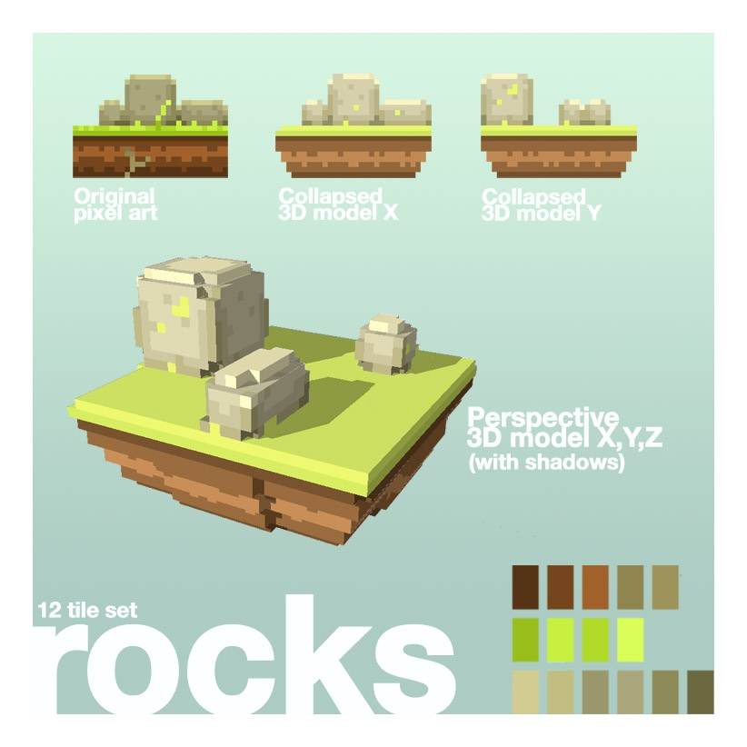
Modelling Triles
First trile concepts made in Google Sketchup (2007)
Notes:
Sketchup :
- Good to test out visual styles initially
Not made to carve this kind of geometry
Took Phil forever to do it
Can't export with the free version

Slide 10
Trile Sculpting
Notes:
Trixel sculpting in the editor
Realtime mesh simplification
Start with 8-face cube and carve chunks out
Texturing is managed externally

Slide 11
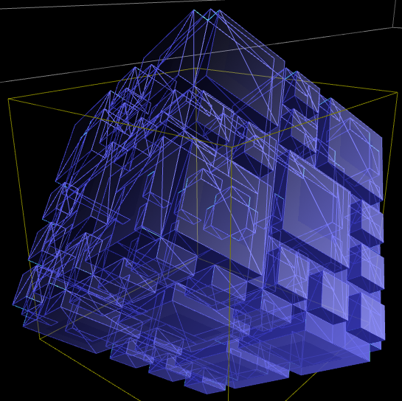
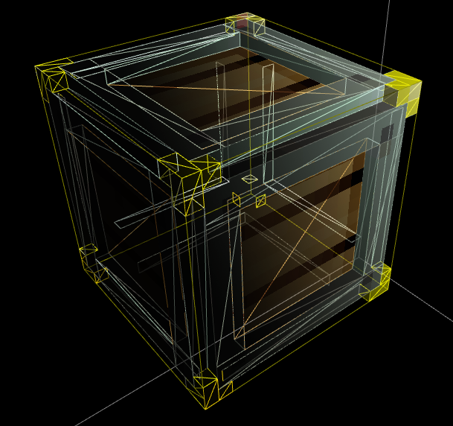
Blocky But Detailed
Average of 136 polygons per trile
Typical scene : 50,000 polygons
But anywhere from ~5000 to ~250,000
Notes:
All surfaces are planar, but
there can be pretty complex triles, and
it shows when the world rotates.

Slide 12
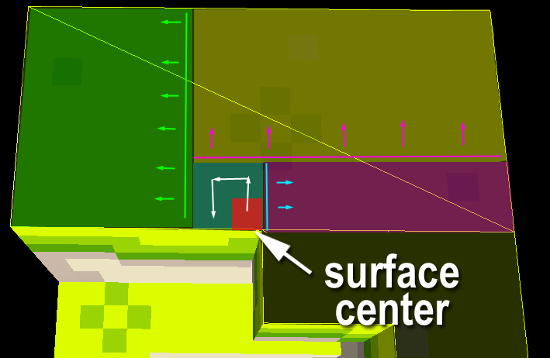
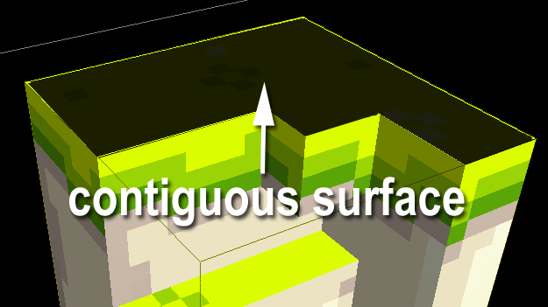
Mesh Simplification
Extrapolate contiguous surfaces from trixels
For each surface,
Enumerate biggest rectangles in that surface
Each rectangle becomes a plane
Notes:
Trile made of trixels
I keep track of presence like voxels (there or not)
From that,
Detect all the outwards-facing faces for trixels that have no neighbour in that direction,
List contiguous surfaces
From surfaces,
Use 2D spiral traversal from the center of the surface to tag the biggest possible rectangle in each surface.

Slide 13
Building Levels in “Fezzer”
Notes:
Much like sculpting triles, but for the whole level!
All the blocks = white & untextured
Can build the level like Legos
Then load a trile set and “paint” it. Also (tools) :
Group stuff together
Move it around - Rotate triles, etc.
Ability to see level from four sides at all times to see how it plays. Everything’s done from the editor.

Slide 14
Completed level in final Fezzer
Notes:
I’m not an artist nor a level designer
Here’s what Phil can do with the tool
(and his mad pixel art skillz)

Slide 15
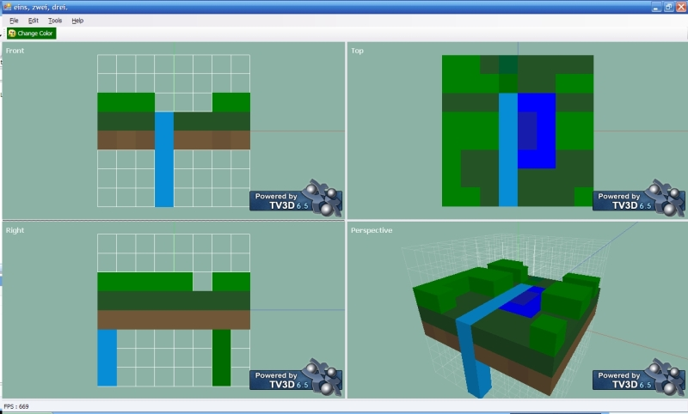
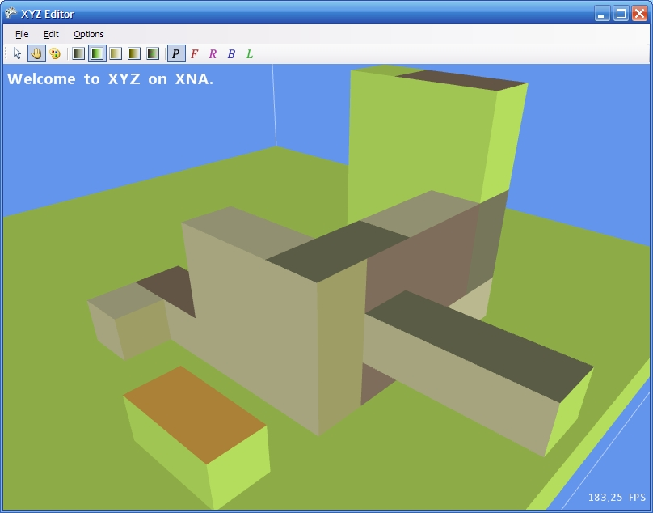
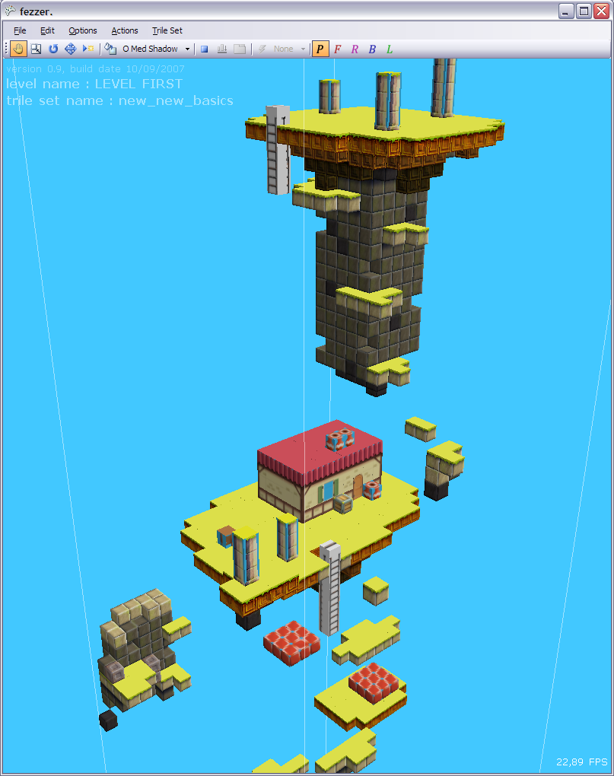
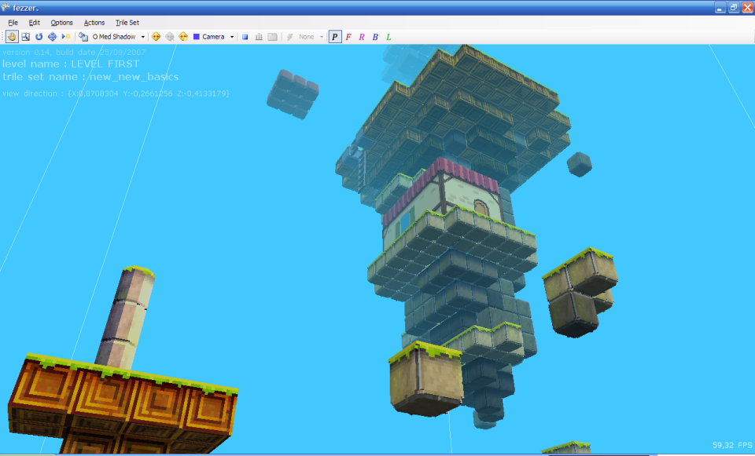
Building Fezzer...
Notes:
A couple shots “under construction” shots of Fezzer
First prototype not in XNA, in TV3D because it’s what I knew (yay watermarks)
More of a CAD interface, with 4 views, and per-trile coloring
Phil preferred face extrusion
Second prototype fullscreen, face selection & extrusion; but no triles yet; just faces & colors
Triles came in after, with cubemap textures Then trixels! And this is the IGF’08 level.

Slide 16
Feature tracking
Google Docs all the way!
Sprints planned 1 week to 1 month ahead
Do basic feature first, revisit & polish later
Notes:
After basic interface implemented, features came in organically.
Either face to face discussion or email, when a sprint is started.
Phil reports bugs, we prioritize and fix. Can fix on the spot if simple enough.
Features are pushed or dropped based on importance or complexity.
Tracking as simple as you can make it and still be intelligible
Too complicated tracking means you won’t use it,
Too simple means it won’t help you.

Slide 17
Designer vs. Programmer Dynamic
Phil dictated design, but I implemented
As the programmer, YOU know what’s possible
Time-wise, performance-wise, and in regards to your abilities
You can always say no, but it’s a discussion
FEZ is a “game d’auteur”, designer associates with it deeply
It’s all about mutual respect
Notes:
If phil says “it would be really cool to have animated trixels for NPCs!”, I’m the one to say “won’t happen”
There’s always tradeoffs.

Slide 18
A note on Version Control
Holy shit you guys, use version control.
Used local NAS with batch file madness for whole 2009
Lost content, overwritten files, flaky backups
“I’m just one guy” and “I have infinite undo levels” are not good reasons
Remote SVN/Git/Hg servers are cheap, and they WILL save your ass
Thanks Nathan @ Capy for convincing us to make the jump!

Slide 19
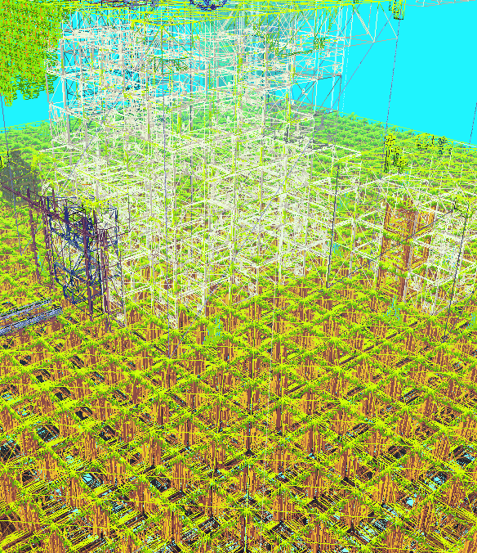
How do we draw all that stuff?
Lots of tiny blocks
Geometry gets pretty dense
Potentially lots of overdraw in 2D views
Ideally 60 FPS on Xbox 360
By culling and batching efficiently

Slide 20
Rendering Triles : Culling
Orthographic views, usually looking into an axis
Peel the frontmost layer(s)
At most two layers if mid-rotation
Cull within view frustum
When moving, only invalidate triles for the screen’s moving border
(don’t recull everything unless necessary)
Notes:
The world is on a grid
The grid is axis-aligned and regular
All triles are individual units
I can cull them independently

Slide 21
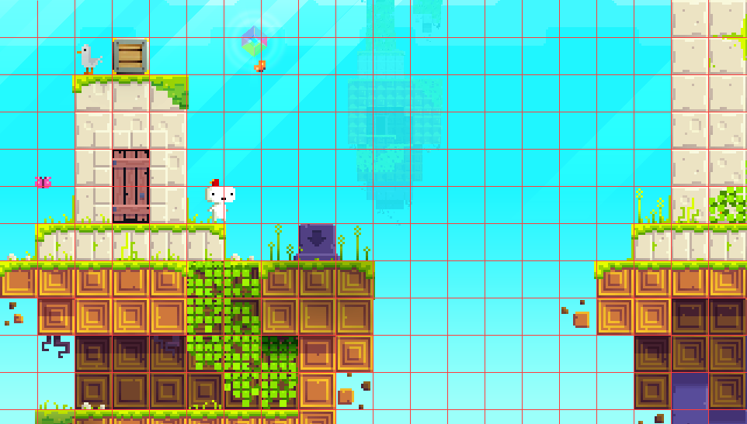
How Culling Works
Cell content is cached
For each screen cell
Start at camera depth
Mark trile to be drawn
Walk into screen
Stop at solid, non-seethrough & non-offset trile
Notes:
When rotation occurs,
Each 2D cell in level (as seen from screen) caches contained triles
to speed up culling
Seethrough triles : vines, doors, grass strands
Offset triles : If moved, we can see behind (like that crate)
Most triles are solid & occupy entire cell

Slide 22
Culling Disabled

Slide 23
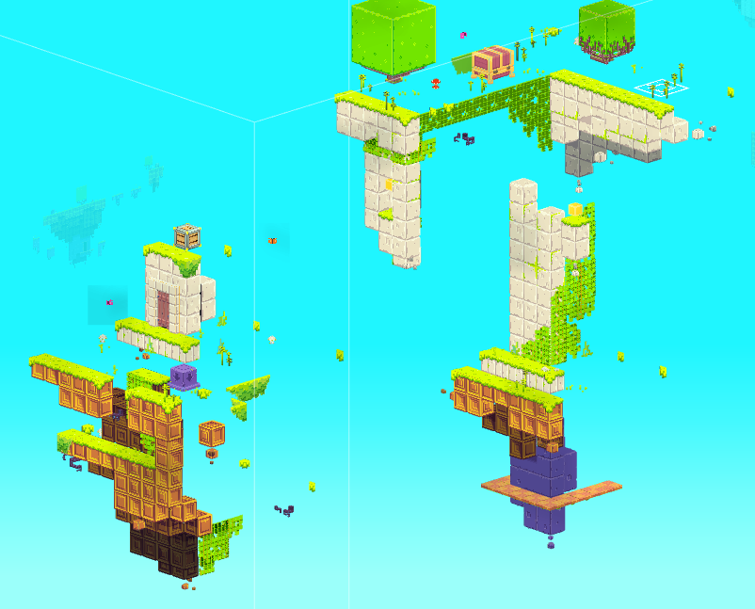
Culling Enabled (~3X less triles)
Notes:
Absolutely no difference visually from non-culled version (in the right viewpoint)

Slide 24
Rendering Triles : Batching
Draw calls are expensive
All triles are independent (so indie)
Can’t just throw everything at the GPU
Batching is a must
But dynamic culling means dynamic batching...
Is there a simple way?
Notes:
Preparing and sending draw calls is very costly,
moreso in XNA.
Can’t batch everything once,
batch contents keep changing as we cull.

Slide 25
Rendering Triles :Batching Instancing
Lots of instances of a single trile type in a level
Few things specific to an instance
XYZ Position, Y rotation : 4 single-precision floats
vfetch instancing on Xbox 360
≈ Shader Model 3.0 Hardware Instancing on PC
Max. 256 instances of the same trile per draw call
Notes:
Instancing to the rescue!
Instancing is :
Taking a redundant model,
Adding a set of small instance data,
And throw them as a batch to the GPU.
226 => Theoretical maximum of 256, but some other VS constants taken by uniform parameters or constants

Slide 26
How-to : GPU Instancing (Xbox)
A static vertex buffer
Vertex data of the template trile (lightweight)
A dynamic index buffer
One set of indices for each instance
Offset indices as if you’d have as many clones in vertex buffer
An instance data buffer
Actually a 4D vector or 4x4 matrix array in vertex shader constants
Contains the instance-specific data
Notes:
Three things needed for geometry instancing.
VB is light despite a lot of geometry output!
Index buffer is larger, can’t avoid it, but still only integers.
At most 16 floats (4x4 matrix) of data per instance.

Slide 27
Xbox Instancing Vertex Shader
int vertexIndex = mod(IN.Index, VertexCount); // Index is an automagic vertex input semantic
int instanceIndex = IN.Index / VertexCount; // VertexCount is uniform parameter fed by app
asm
{
vfetch position, vertexIndex, position0
vfetch normal, vertexIndex, normal0
vfetch textureCoordinate, vertexIndex, texcoord0
}; // vfetch magic gets appropriate vertex data
float4 InstanceData = InstanceDataArray[instanceIndex];
float sinPhi, cosPhi;
sincos(InstanceData.w, sinPhi, cosPhi); // W component contains Y-axis rotation angle
float4x4 instanceMatrix = // Recompute instance transformation matrix
{
cosPhi, 0, -sinPhi, 0,
0, 1, 0, 0,
sinPhi, 0, cosPhi, 0,
InstanceData.xyz, 1
};
Notes:
Sorry if this slide is dense/technical.
Our approach :
4D vector per instance
W component holds Y-axis rotation
Instead of whole 4x4 transformation as parameter, rebuild it inside VS
4x more instances per batch!

Slide 28
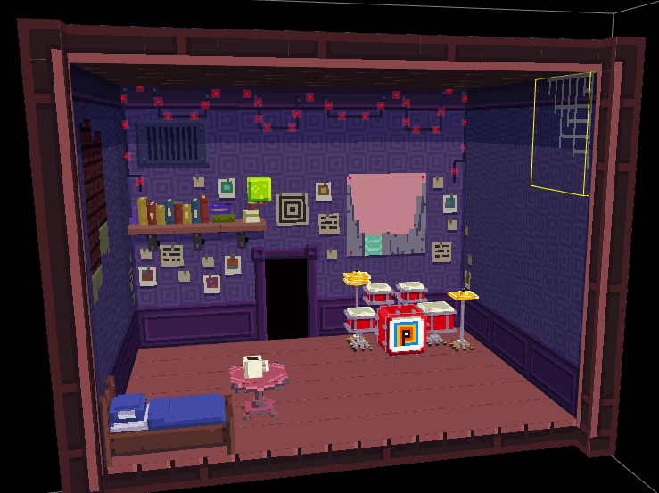
Other Stuff : Planes/Decals
Where sclupting doesn’t matter, or sprite animations
Notes:
Gomez’s house + many other house interiors = mostly planes
Can’t tell the difference
Easier to draw whole slab of 2D art than split it in 16x16 chunks
Other planes :
Explosions
NPCs & wildlife
Gomez
No support for animated trixels. (shout out to Voxatron)

Slide 29
Other Stuff : Art Objects
For small overlapping details, or unique bigger landmarks
Notes:
Sculpted & textured like triles, but bigger
When splitting in 16x16 chunks is impractical
Also instanced (lots of duplicates)
All circled little green thingys are art object
Don’t fit in grid model, overlap triles

Slide 30
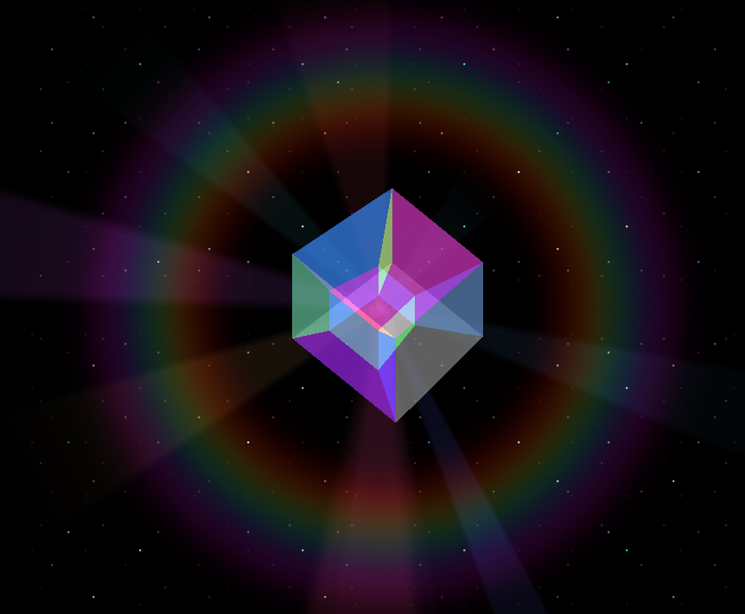
DOT the Tesseract
4D hypercube fairy
Continually rotates about the X-W plane
Done in C# (on the CPU)
4x4 matrix works for rotation
Faux 4D to 3D projection
Further out in W axis = smaller in 3D
Rendered in orthographic projection like everything else
96 vertices, 144 triangles
(no intersection in 4D space)
Notes:
You might’ve noticed DOT in earlier shots/videos
She’s FEZ’s “Navi” or “Fi”
Story-wise it makes sense that she’s one-step-beyond what Gomez can see, hence 4D

Slide 31
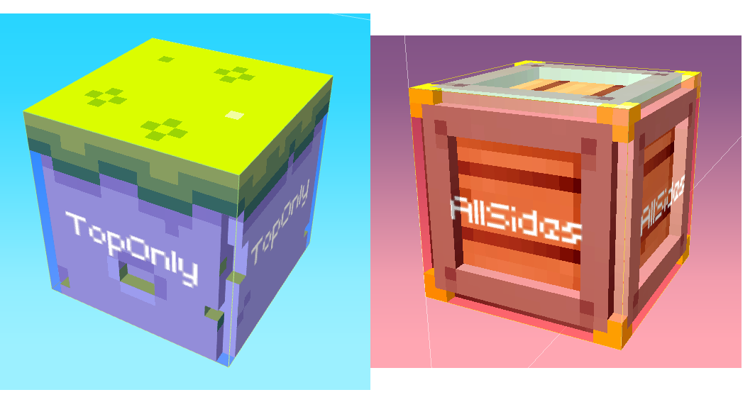
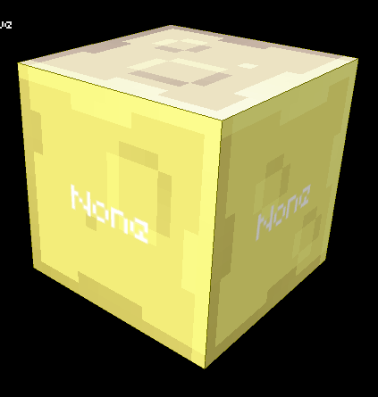
Collision Management
Triles are the collision map
Each trile has a type
Can be per-face too!
Four types
Immaterial (blades of grass)
No collision (background elements)
Top-collide (most platforms)
All-collide (blocking boundaries; rare)
Notes:
World mostly made of triles
=> Why not using them directly for collision info?
No-collide => Unlike immaterial, push Gomez forwards
All-collide => interior closed-up areas.

Slide 32
Invisible Collision Triles
Art objects need to collide too
But they’re not made of triles!
Filled with invisible triles
No collision, or
Top-only collision
Notes:
These are costless to the renderer.
Only used for collision.
In that case,
Triles really act as a collision map...

Slide 33
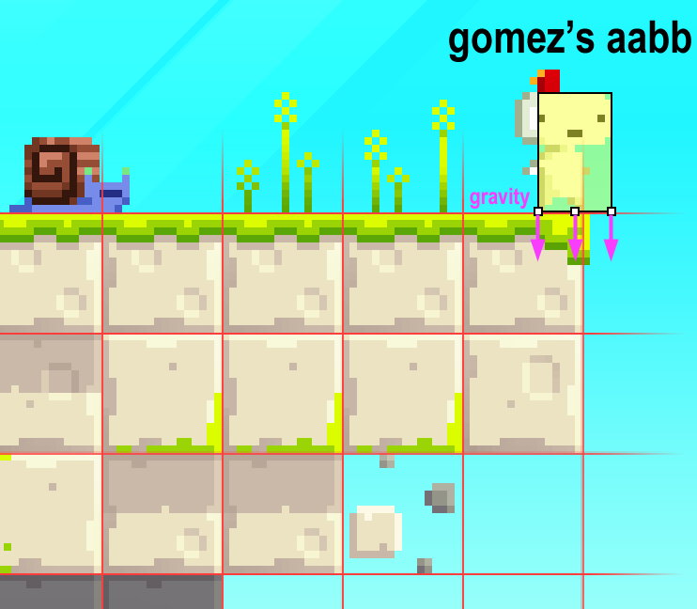
Collision Lookup
Similar as the culling process
Collide with what you see!
Peel back from view
Keep peeling back if hitting
Immaterial triles (i.e. grass strands)
Non-grid-aligned triles
Otherwise, point-to-line with first solid trile edge found (three points), one axis at a time.

Slide 34
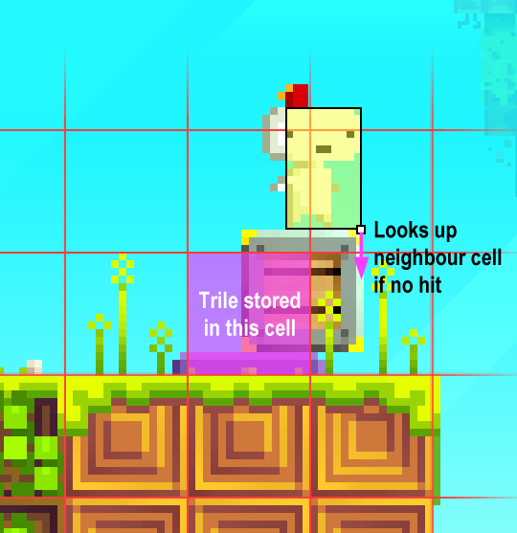
Non-Grid-Aligned?
Triles can be moved arbitrarily
Stored in cell that contains its center
Collision tests look up neighbours
Only one, away from cell’s center
Only if no hit in current cell
Once found, point-to-line (using appropriate size & offset of the trile)

Slide 35
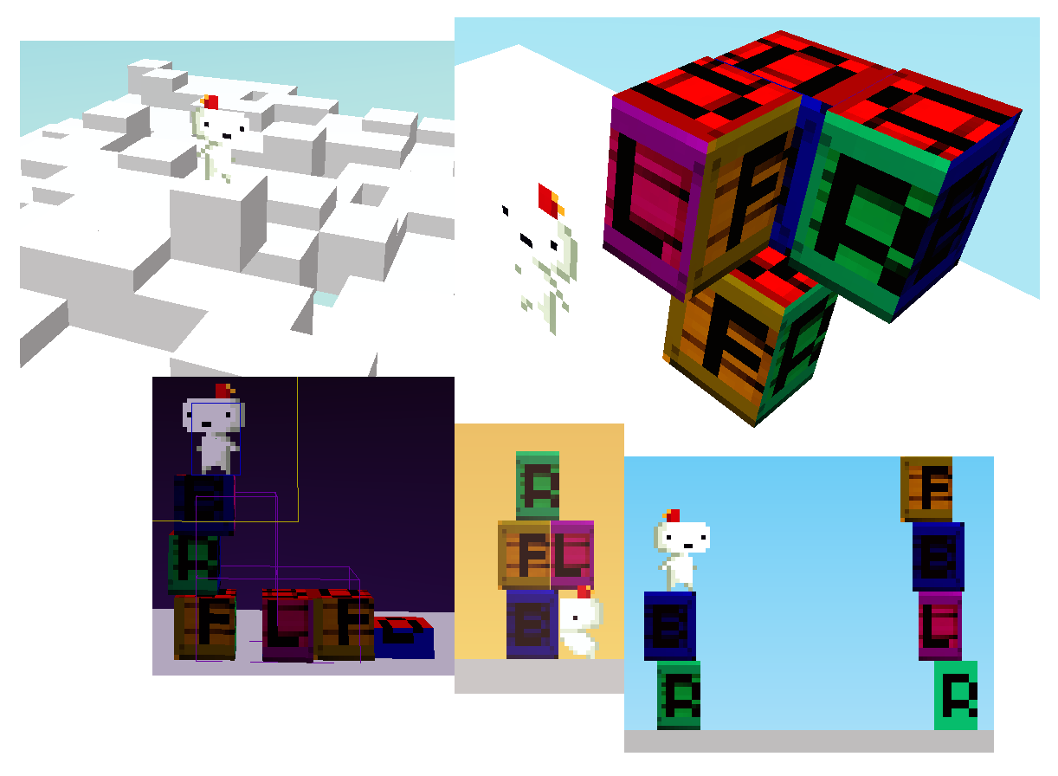
Tests...
Scaling can also be arbitrary
As long as triles are no smaller than half of Gomez’s size
(limitation of using
point collision)

Slide 36
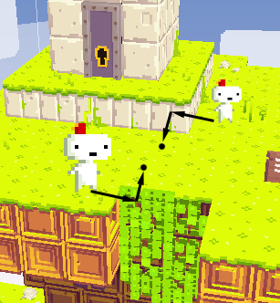
How Gomez moves around
Movement is along on the view plane
Depth correction rules
Gomez should stay visible, always
Gomez should never walk in mid-air
Otherwise, don’t touch his depth
During view rotations, movement & time are suspended

Slide 37
Background Mode
If Gomez is behind the level post-rotation
IGF’08 build : Panic & QTE!
Stressful, kills the mood, generally dumb
Final build
Silhouette rendering
Low-pass music
Limited actions
Notes:
Idea is to
communicate smoothly that he shouldn’t be there.

Slide 38
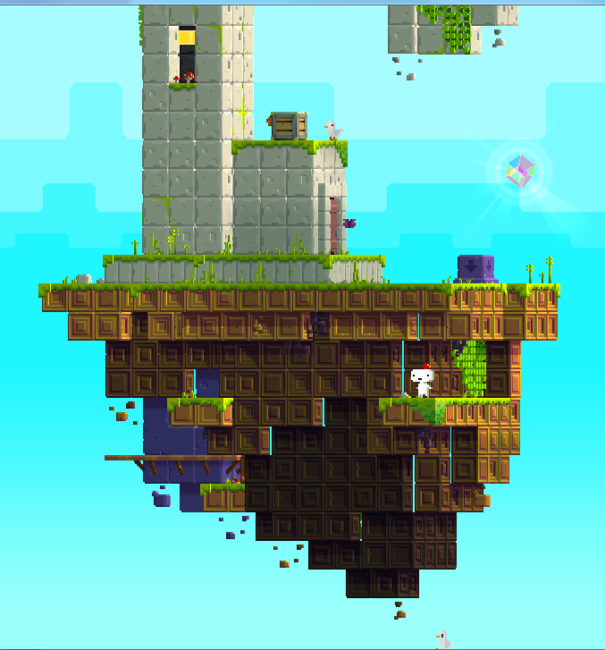
Lighting Pre-Pass
Per-face direct/diffuse light
Ambient light = sky background color
Cloud shadows end up blueish
Shadows and additional lights added
(in screen-space)
All done in a lighting pre-pass
Blended in Modulate2X mode
so that it can light up and shadow
Notes:
Lighting is done in 2D with planes,
NOT point lights
Ended up doing a pre-pass :
Shadows can max-out
Lights can cancel shadows without altering colour
Lights can add, and be coloured Without pre-pass, albedo information is lost in shadows
Con : Need to draw everything 2X

Slide 39
Time Of Day Lighting
Notes:
This is 8x speed day/night cycle
Time is mostly visual/aural/atmospheric,
but has gameplay implications in some areas
Sky color defines :
Sky layer tinting color (“fog color”)
Ambient light color
Clouds & cloud shadows become less apparent at night
Additional post-process during dusk/dawn/night
...to make colors pop and dull colors at night
Talk about texture sampling!

Slide 40
World Interactions
Gomez can :
Grab/push/pull objects
Rotate parts of the world independently
Make blocks crumble under his weight
Grab ledges all around platforms
Interact with one-off puzzle objects
Swim in water & drown in toxic liquids
AND MUCH MUCH MORE
56 different “action classes” control his behaviour
Notes:
Every action type has associated animation too.

Slide 41
Action “Classes For States”
All player action classes derive from a base abstract class
Not all mutually exclusive
“Fall” is an action that is evaluated as long as there’s gravity
They know how to chain from state to state
protected virtual void TestConditions()
{
}
protected virtual void Begin()
{
}
protected virtual void End()
{
}
protected virtual bool Act(TimeSpan elapsed)
{
return false;
}
Notes:
Actions classes know when they need to start taking control
Basically avoids doing a bit “switch” or having a million booleans.

Slide 42
Example : WalkRun.cs
protected override void TestConditions()
{
switch (PlayerManager.Action)
{
case ActionType.Sliding:
case ActionType.Idle:
case ActionType.Teetering:
case ActionType.Grabbing:
case ActionType.Pushing:
case ActionType.LookingAround:
// If grounded and pressed movement keys
if (PlayerManager.Grounded && InputManager.Movement.X != 0 &&
PlayerManager.PushedInstance == null)
{
PlayerManager.Action = ActionType.Walking;
}
break;
}
}
Notes:
They are backed by an enumeration that has all the different states.
This is how they find out when to start acting,

Slide 43
Example : WalkRun.cs
protected override void IsActionAllowed(ActionType type)
{
return type == ActionType.Running || type == ActionType.Walking;
}
protected override bool Act(TimeSpan elapsed)
{
// Transform input to physics impulses in a helper class
MovementHelper.Update((float)elapsed.TotalSeconds);
if (MovementHelper.Running)
PlayerManager.Action = ActionType.Running;
else
PlayerManager.Action = ActionType.Walking;
}
Notes:
...whether or not the action class is active,
And what’s going on when they act.

Slide 44
Additional Flags for Actions
public static class ActionTypeExtensions
{
public static bool IsAnimationLooping(this ActionType type)
{
switch (action) { /* ... */ }
}
public static bool DisallowsRespawn(this ActionType type)
{
switch (action) { /* ... */ }
}
public static bool PreventsRotation(this ActionType type)
{
switch (action) { /* ... */ }
}
/* ... */
}
Notes:
There’s also many other flags based on the enums that defines other behavioral characteristics.

Slide 45
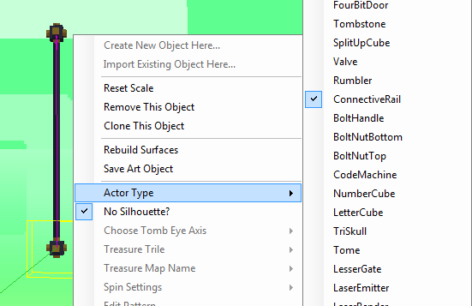
Actors : Dynamic World Entities
Spinning blocks, moving platforms, ladders, interactive structures, etc.
Hardcoded behaviours with flags or parameters set in the editor
Tradeoff for not having proper scripting support
Notes:
Actors are
tagged trile groups,
art objects or
even volumes or planes
that do specific things in-game.
Usually have a “manager” class that handles all instances of them in a level.

Slide 46
Scripting System
Designer-friendly UI (no code!)
Event-based
Notes:
Was made such that Phil can add and edit scripts without fearing syntax errors.
Here’s an example of complex scripts
Act on Gomez actions, entering volumes of space in level, level events, etc.
Control camera, control tutorial prompts, dialogue...

Slide 47
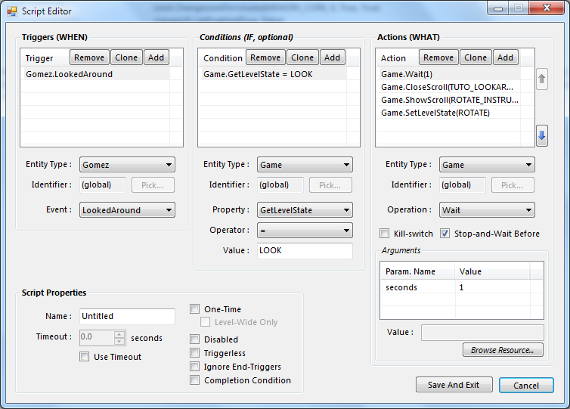
Script Editor
Triggers
Conditions
Actions
And lots of WinForms controls

Slide 48
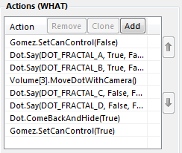
Script Example : DOT interaction
Warn the player of a particular mechanic in a level using DOT
When Level Starts, (Start event on Level static entity)
(blocking actions executed in sequence)
Remove player controllability
DOT says a couple lines
Move the camera to Volume #3 (point of interest)
DOT says more stuff
DOT comes back and hide
Player regains control
This script happens once in the game :

Slide 49
Scripting Interfaces
[Entity(Static = true)]
public interface ILevelService : IScriptingBase
{
// Events, for triggers
[Description("When the level starts")]
event Action Start;
void OnStart(); // Called by the engine to trigger the event
// Properties, for conditions
bool FirstVisit { get; }
// Operations, for actions (can be running over time à la coroutine)
[Description("Smoothly changes to a new water height")]
LongRunningAction SetWaterHeight(float height);
}

Slide 50
Level Format
At design-time, serialized from objects to SDL
Similar to YAML or JSON, but better integrated with .NET
Tweakable by hand
Error resilient
Ignores unknown elements
Elements can be marked as optional
At compile-time, binary format for performance & filesize
No automatic serialization, reflection is too slow on Xbox
Notes:
Chose not to use XML because levels (& triles) are formed of a LOT of cells
Direct XML representation was too dense, hard to read, heavy on disk, long to load

Slide 51
SDL Looks Like This
Output much more concise than equivalent XML serialization
Serialization tags in data objects
level type="FezEngine.Structure.Level, FezEngine" {
name "ARCH"
startingPosition {
face "Front"
id 16 6 5
}
size 30F 49F 35F
baseDiffuse 1F
baseAmbient 0.35F
haloFiltering true
blinkingAlpha false
waterHeight 11F
skyName "WATERFRONT"
trileSetName "Untitled"
volumes {
volume key=0 {
orientations "Front"
actorSettings {
farawayPlaneOffset 5F 1F
}
from 3F 26F 15F
to 4F 28F 16F
}
public string Name { get; set; }
public TrileFace StartingPosition { get; set; }
public Vector3 Size { get; set; }
[Serialization(Optional = true)]
public float BaseDiffuse { get; set; }
[Serialization(CollectionItemName = "Trile")]
public Dictionary<TrileEmplacement, TrileInstance> Triles;
Notes:
Vector3 collapsed to single lines instead of x, y, z
Especially useful for large collections of vectors
Dictionary serialization is lean if key can be collapsed to a single line
No block-end marker, easier on the eyes if you like curly braces! (and who doesn’t, cave story what what)
I definitely suggest you look up more collapsed data languages like SDL and YAML.

Slide 52
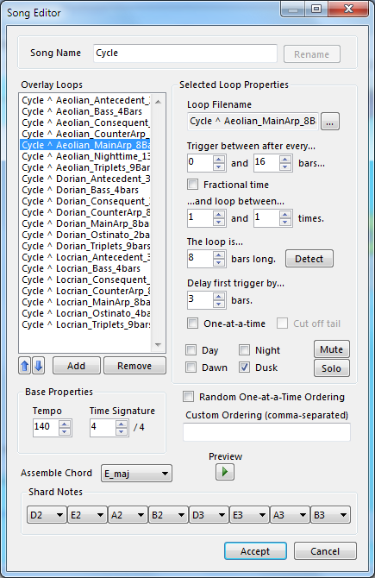
Music System
Written on-top of XACT
Allows infinite, dynamic track-based songs
Scriptable
Level/player events can mute/unmute tracks
Works with time of day
Notes:
Music system is a big part in FEZ, atmosphere and sense of place
Disasterpeace used it to track all game music

Slide 53
Music System In Action
“Puzzle-solving music” @ daytime
Night is less dense, very different sounding and still randomized :
Track | Initial Delay | Duration | Inter-Play Delay
Main Arp | None | 8 bars | [0, 16] bars
Counter Arp | 4 bars | 8 bars | [0, 16] bars
Ostinato | 8 bars | 4 bars | [0, 16] bars
Bass | 8 bars | 4 bars | [0, 24] bars
Antecedent | 16 bars | 3 bars | [0, 16] bars
Triplets | 16 bars | 9 bars | [0, 16] bars
Consequent | 20 bars | 3 bars | [0, 16] bars

Slide 54
Xbox-specific Optimization
XNA on the Xbox 360 = .NET Compact Framework
Garbage collection every 1Mb allocated, unpredictable, blocking
Rules of thumb : avoid LINQ, dynamic allocations
Draw calls are expensive : batching is essential, instantiate ALL THE THINGS
Defer as many operations as possible to vertex shaders instead of CPU
Otherwise, multithread; 5 cores at your disposal
HDD access is slow, flash memory access is worse!
Pre-load all content, avoid disk access later on
You probably have more RAM than content (in FEZ, totally)
Notes:
Lots of content on the Web about this
...especially since XBLIG games have the same issues

Slide 55
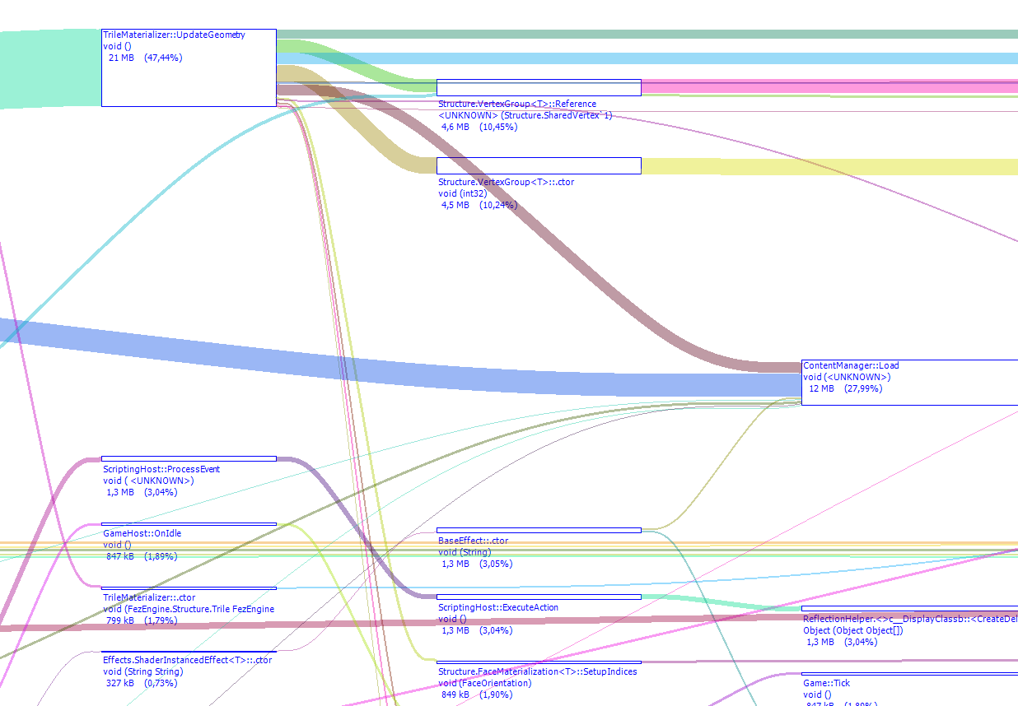
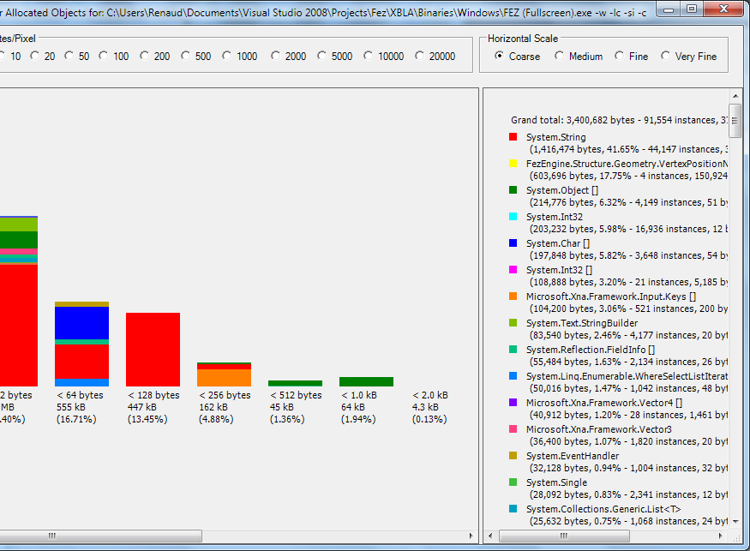
Tools : CLR Profiler
Excellent, free memory profiler
Allocations graphs, memory usage by class
Good for identifying real-time garbage & why load-times stall
Notes:
Start profiler, don’t do anything, wait 20-60 seconds, check reports. If you get allocations, that’s garbage and you know where it comes from.

Slide 56
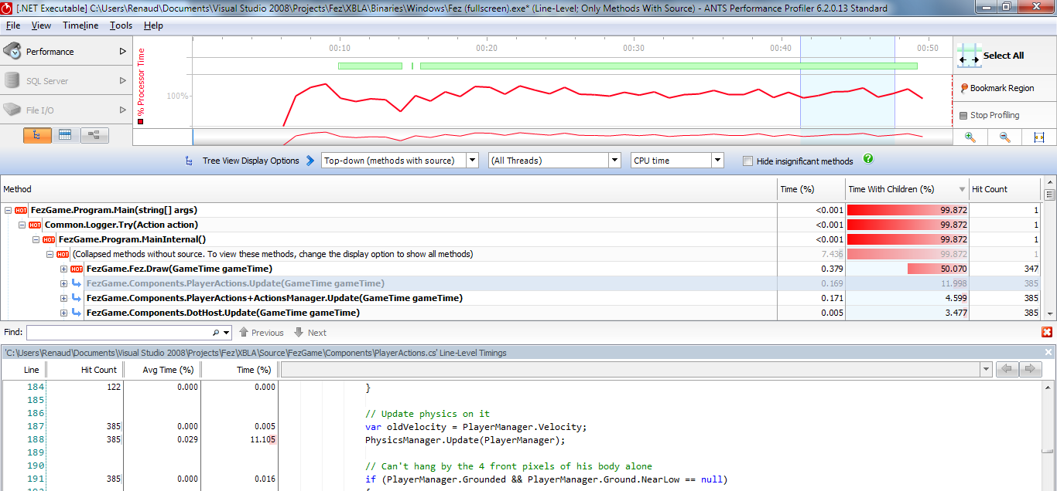
Tools : CPU Profiler
Any one you want (AQTime, dotTrace...), but I like ANTS Performance Profiler a lot
Absolutely essential for finding bottlenecks
Notes:
Let the game run for a while,
Do things that you feel are expensive or slow game down,
Highlight section of the gameplay, and look at “hot methods”.
Sometimes surprising!
Explosions were slow in FEZ, I thought it was the particles
It was actually too many sounds being created.
Easy to go on optimization spree and optimize stuff that,s not worth it.
Microoptimization can be useful, just need to know where.

Slide 57
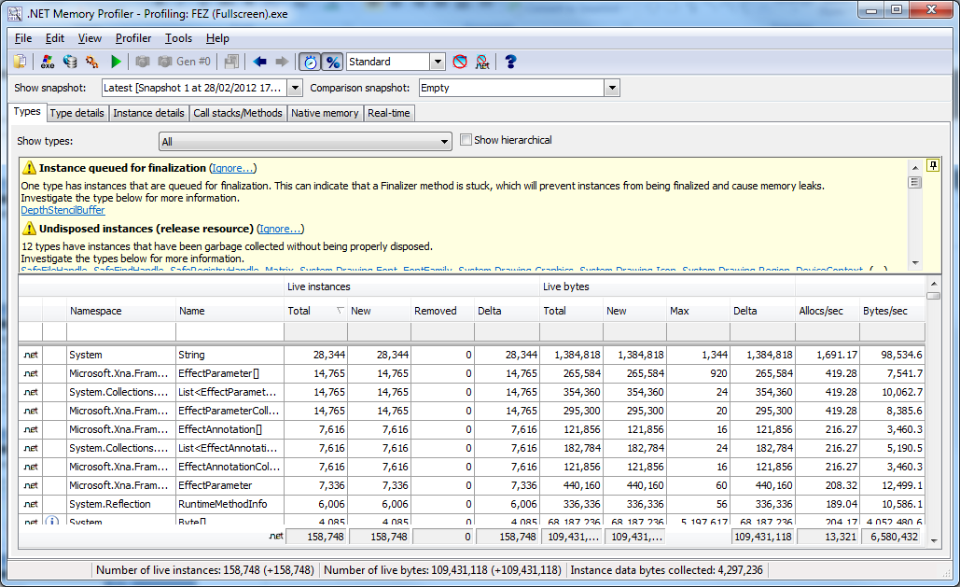
Tools : Analyzing Memory Profiler
CLR Profiler is good for garbage generation, but isn’t very helpful for leaks
I used the SciTech .NET Memory Profiler
Heap snapshot comparisons
Insight on possible problems
Leaky objects are identified and their creation point given
Notes:
Memory leaks are possible in managed languages like C#
Usually caches that are not cleared, references lying around, delegates that are not used but kept, static stuff.
Let the game running,
Capture heap at a certain point,
Move around, change level, change context, restart game, what have you
Recapture heap
Check old references and stuff that wasn’t cleared
Disposable objects not disposed,
Disposed objects not garbage collected,
Etc.

Slide 58
XDK Tools
All other tools worked with a PC build; what if stuff only happens on Xbox?
xbWatson
Make your own measurements and output to console
PIX
Frame-by-frame teardown of what’s costly
Excellent for inspecting the draw calls & shaders
CPU Performance Profiler in the XDK ultimately useless
Made for native code, not .NET games

Slide 59
XNA on XBLA : My Experience
Long dev cycle meant struggle with upgrades
No native library allowed, only .NET : can be problematic
Some boilerplate TCR stuff handled, but still a lot to think about
No symbols for debugging .NET assemblies in Release builds
But...
.NET, C#, XNA and WinForms make engine & tools dev way easier
Transition from PC to Xbox all in all fairly painless
It’s all about comfort : I couldn’t have done FEZ in C++
Notes:
We avoided XNA 4.0 and hit roadblocks later with known bugs
Low-quality video playback in 3.1
TCR struggles : we didn’t even do multiplayer
Bugs with LIVE disconnection, wierd workarounds that everyone has to make, why?

Slide 60
A lesson is learned...?
I don’t think there’s a way around it : a first game is HARD to finish
Especially if you care a lot about it
And let’s face it, FEZ is a huge game
Early showing was a double-edged sword
But later PAX/Fantastic Arcade showing were great motivators & feedback tools
Feature creep, constant feeling that finish line is 3-6 months away
Making short-form “game jam” games helped learn scope control

Slide 61
If I had to do it again...
Use middleware (Unity?), or hire an engine programmer
Have real scripting support and educate artists about it
Hot-reloadability of scripts and content edits
Even if C# compilation is fast, back & forth is huge waste of time
Don’t be afraid to scrap prototype code
4-year-old bugs coming back to haunt you : it sucks
Realize you’re doing a big, long project, and that it’s worth the effort
Notes:
Making the engine, the tools, the game at the same time is too much work
A real clean-cut engine, and whole game as scripting, robust scripting support which we didn’t think we needed– needs to be done from the get go
By rebuilding you will fix those bugs without thinking about it
Have to realise that there is value to thinking it over

Slide 62
That’s all, folks!
Thanks for coming!
Questions?

